Slide 1
Deep Learning Training
Lecture 5: Transfer Learning and CNN architectures

Slide 2
Content
Transfer Learning
Some Widely Used Architecture
AlexNet
VGG
ResNet
Inception
MobileNet

Slide 3
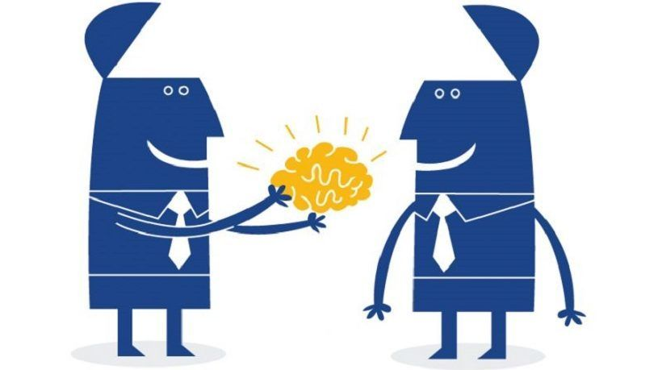
Transfer Learning
Can we use one trained networks learning for another related task?
Idea of transfer learning is to use the trained model in another task
This may reduce training effort a lot

Slide 4
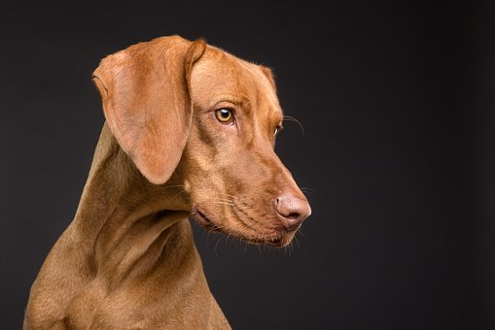
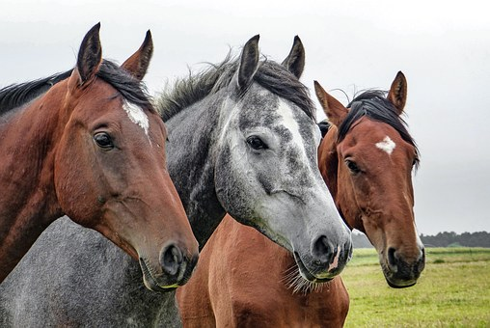
Transfer Learning Example
Many task have similarities in low level
For example, in image classifier CNN the earlier convolution layer acts as a feature extractor. Later a fully connected layer use this features to classify the image
If the images to be classified are related then the same feature extractor can be used. For example a trained dog breed classifier’s feature extractor may be used for horse breed classifier

Slide 5
Transfer Learning Advantages
Deep learning to be fruitful requires lot of data to learn all the parameters
By using already learned weight, required number of parameters to learn can be reduced a lot
This reduction reduces the needed amount of data
Also less data and less parameter to learn means less computational resource
One successful research can be used in many tasks.

Slide 6
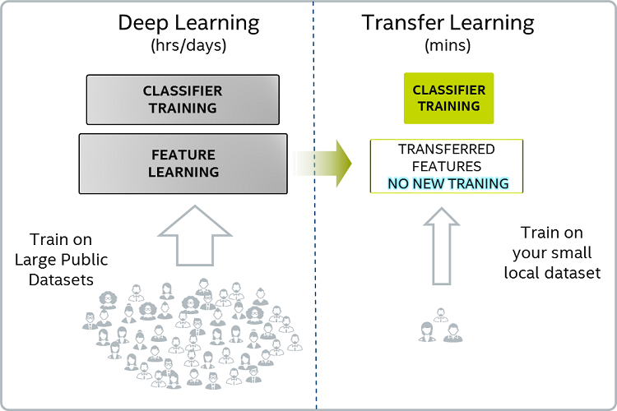
Transfer Learning Simplified Diagram

Slide 7
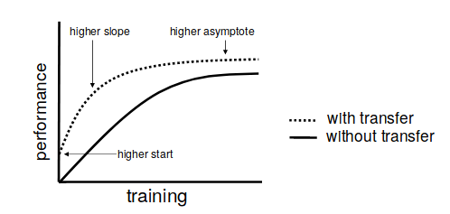
Transfer Learning Advantage
Transfer learning gives a better start for a model. So, better performance can be achieved quickly.ref[1]
image source[1]

Slide 8
Transfer Learning Advantage
Less amount of data is needed as smaller part of network needs fine tuning
Less computation resource
Transfer learning can be used to generate useful representation which can be used to compare similarities. e.g. FaceNet for face detection
Though transfer learning is used mostly with pretrained CNN it is not limited to it ref[2]

Slide 9
Deep Transfer Learning Categories
Deep Transfer learning can categorized into following according to the approach of transferring knowledge ref[3]
Instances-based
Mapping-based
Network-based
Adversarial-based

Slide 10
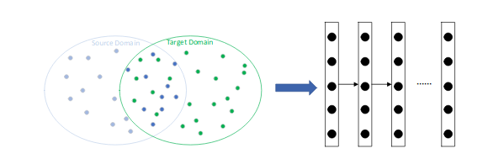
Transfer Learning Categories
Instances based transfer learning
image source[2]

Slide 11
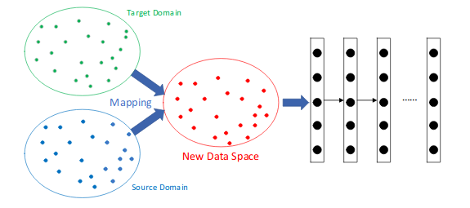
Transfer Learning Categories
Mapping based transfer learning
image source[2]

Slide 12
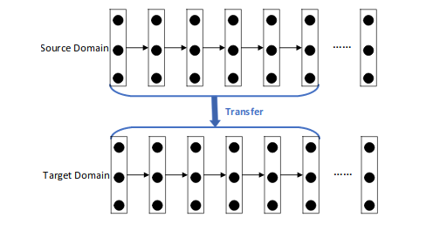
Transfer Learning Categories
Network based transfer learning
image source[2]

Slide 13
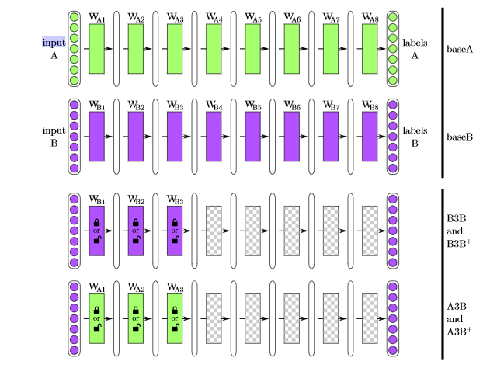
Transfer Learning Network
ref[11]
Fig: Network with transfer learning from network base A and base B

Slide 14
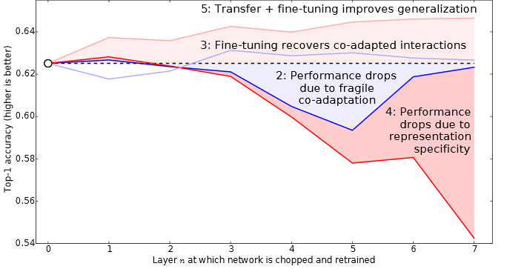
Performance of Transfer Learning
ref[11]
Fig: Performance of transfer learning comparing with other fine tuning approach

Slide 15
Some Widely Used CNN Architecture
Among many architectures found by research on image classification, some have achieved popularity and used by many as base for transfer learning in image classification
Here we will present.
AlexNet
VGG
ResNet
Inception
Another architecture we will see is called MobileNet is used in mobile devices for it’s low overhead while sacrificing some performance

Slide 16
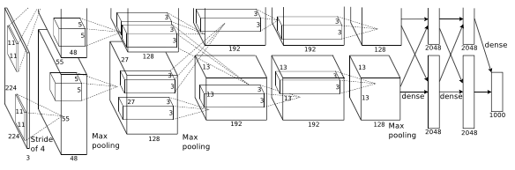
AlexNetref[4]
Breakthrough result in ImageNet LSVRC-2010 contest
Produced 37.5% top-1 error rate which beat the state of the art then.
Consist of five convolution layer and three fully connected layer
It has 60 million parameter
image source[3]

Slide 17
VGGref[5]
Got first place in localisation and second place in classification problem in ImageNet 2014 competition
Proposed six architectures and showed performance improvement with increase of depth (upto 19 layers )
In VGG network, larger kernel convolution is replaced with multiple smaller kernel convolution. For example 5x5 kernel convolution is same as two 3x3 kernel convolution. Similarly, 7x7 kernel can be done with three 3x3 kernel (without pooling in between)
This breaking down reduces parameter count. So, greater depth can be done without increasing training cost
Also breaking down convolution increases number of rectification (Relu layer). This increase non-linearity of decision.

Slide 18
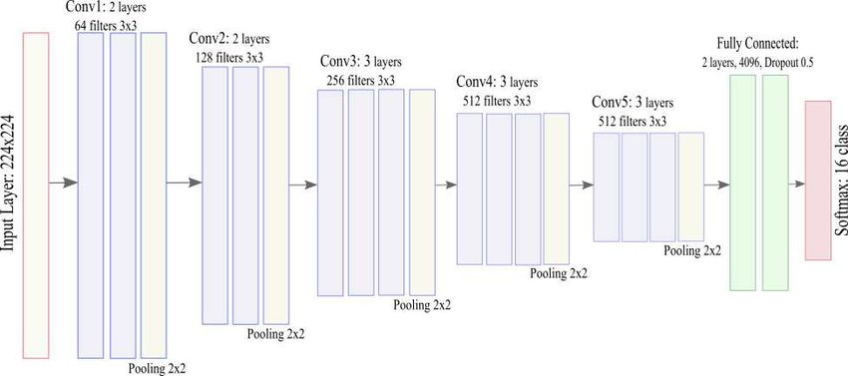
VGGref[5]
Two best performing models are released to be used for further research and transfer learning
Is available as pretrained model in different ML Framework like keras,pytorch etc.
image source[4]
Fig: VGG16

Slide 19
ResNetref[6]
Achieved first place in localization and detection problem in ImageNet 2015 with 3.57% top-1 error rate.
First place in detection and segmentation in COCO competition 2015
This research have shown that plain neural network exhibits greater training error with increase of depth which is counter intuitive
Authors have introduced a residual block architecture
Using this residual block, very deep network can be optimized with better accuracy, unlike plain neural network.

Slide 20
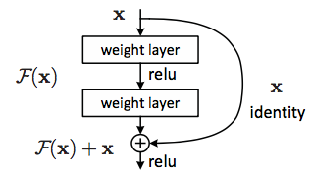
ResNetref[6]
image source[5]
Fig: Residual block

Slide 21
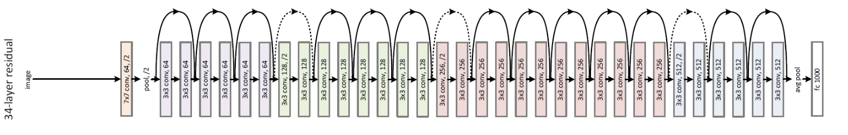
ResNetref[6]
Weight layer of residual block can be of different architecture. In the paper 20 different residual blocks are used
Up to 152 layer network is proposed in the research
Performance is reported for ImageNet, Cifar-10, Pascal and MS COCO dataset
image source[5]
Fig: ResNet 34 layer

Slide 22
Inceptionref[7]
First published paper in 2014 and participated in ImageNet 2014 competition
Outperformed then state of the art performance in classification and detection problem
There are 4 version of it. Inception v1(2014), Inception v2 & v3(2015), Inception v4 and Inception Resnet (2016)
There are two main ideas in Inception Network
To capture important part of image with different size, multiple kernel of different size working at same level may work. Following this idea naive inception block is proposed
To reduce the convolution cost each inception block 1x1 convolution is used to reduce the number of channel of input feed to an inception block

Slide 23
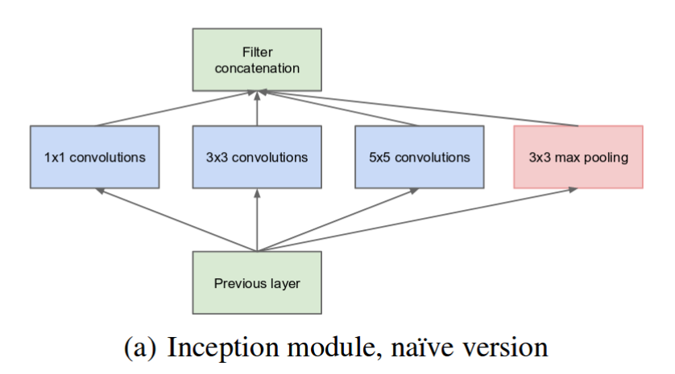
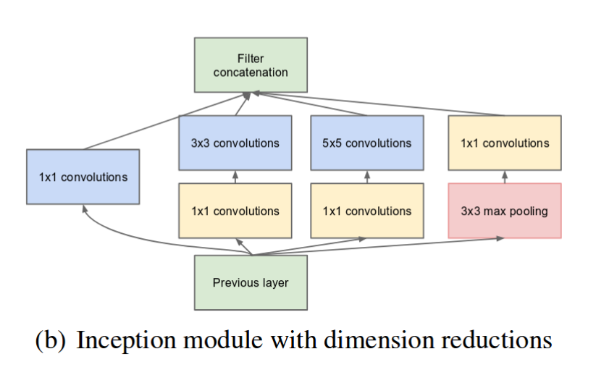
Inceptionref[7]
image source[6]

Slide 24
Inception ref[7]
In Inception v2, inception block’s operation is made cheaper by breaking the convolution operation into multiple smaller convolution. Like breaking down 5x5 convolution into two 3x3 convolution
Auxiliary classifier is introduce at lower layer of network to combat vanishing gradient problem
Inception v3 used some regularization operation and factorization of 7x7 convolution
Inception v4 modifies the layers before the inception blocks and introduce reduction block which will reduce input dimension
Inception resnet includes residual connection in Inception block to increase depth

Slide 25
MobileNet
Mobile Net is a CNN architecture for low power embedded device
Goal is to reduce the amount of computation while sacrificing small amount of performance
To achieve this, MobileNet breaks down standard convolution operation to depthwise convolution
Also two hyper parameters are introduced. Width multiplier α, Resolution multiplier ρ
Width multiplier reduce the input/output channel at each layer by factor of α, Resolution multiplier works to reduce the input size at each layer

Slide 26
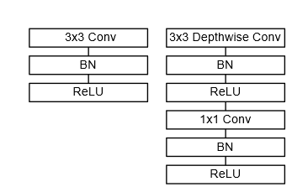
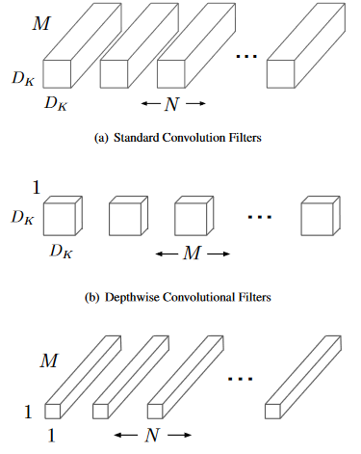
MobileNet
image source[7]
Fig: Breakdown of standard convolution

Slide 27
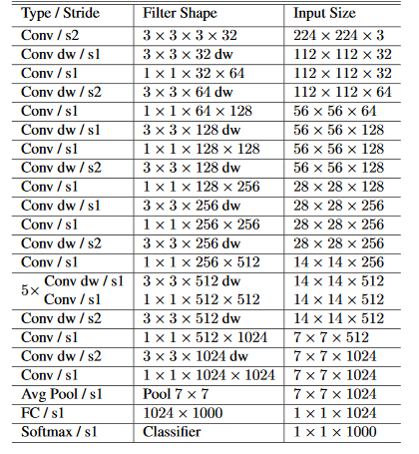
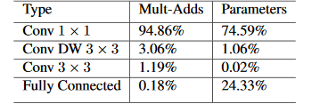
MobileNet
image source[7]
Fig: MobileNet arch. description and resource per layer type

Slide 28
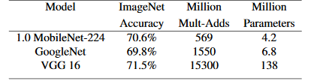
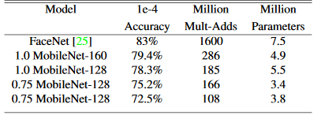
MobileNet
image source[7]
Fig: MobileNet performance comparison in image classification and face detection

Slide 29
Thank You

Slide 30
References & Acknowledgements
references:
http://ftp.cs.wisc.edu/machine-learning/shavlik-group/torrey.handbook09.pdf
https://www.deeplearningbook.org/
A Survey on Deep Transfer Learning
AlexNet
VGGNet
ResNet
Inception
MobileNet
https://swethatanamala.github.io
https://towardsdatascience.com/a-simple-guide-to-the-versions-of-the-inception-network-7fc52b863202
https://papers.nips.cc/paper/5347-how-transferable-are-features-in-deep-neural-networks.pdf
image sources :
http://ftp.cs.wisc.edu/machine-learning/shavlik-group/torrey.handbook09.pdf
A Survey on Deep Transfer Learning
https://swethatanamala.github.io
https://www.researchgate.net/figure/VGG16-Architecture-with-Softmax-layer-replaced-used-as-the-base-model-for-each-classifier_fig1_322787849
ResNet
Inception
MobileNet

